Slide 1

Routing

Slide 2
Agenda
Web App Routing Overview
What is React Router
Server side rendered vs SPA
Static routing vs Dynamic routing
Install React Router
Routes and Data
Basic configuration
Routes matching
Url params and query strings parsing
Render multiple components for the same route
Links and History
Link routes
Style active links with NavLink
Access History
Redirect
Transitions
Animated transitions between pages
Intercept transitions with Prompt component

Slide 3
Web App Routing

Slide 4
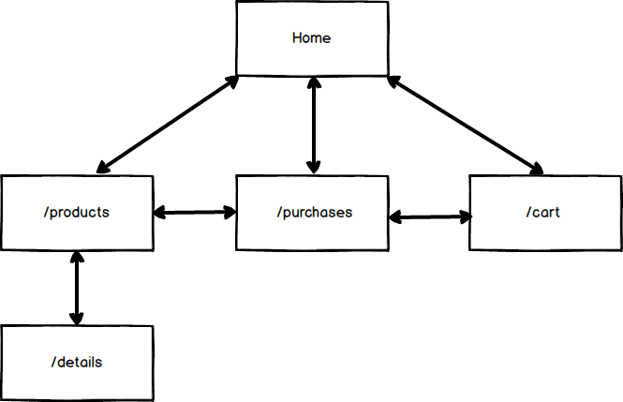

Slide 5
Server side rendered apps
In Server side rendered apps routing is defined on the server
/
Client requests a page
Server parses the request
index.html
/about
about.html
Notes:
There’s more to a React Component, but will get to that in a bit

Slide 6
SPA
In Single Page applications server returns one page for every request. Client side router defines page content
/
Client requests a page
Server parses the request
index.html
/about
index.html
Notes:
There’s more to a React Component, but will get to that in a bit

Slide 7
Why Routing?
App sections can be made shareable and navigable
Properly designed routes can make the user understand the context better
Intuitiveness
Changing URL manually to reach a certain area
Improves usability by integrating with back/forward browser buttons
Combined with server-side rendering, can assist greatly with search engine optimizations (SEO)

Slide 8
History API vs. Hash-based
Two key alternatives for client-side routing
Hash-based
https://myapp.com/#/products/list
HTML 5 History API (pushState)
https://myapp.com/products/list
Hash based
Wider browser support
Doesn't require server-side URL redirection/rewrite
History API
More clear, intuitive, and consistent URL's
Plays together more nicely with server-side rendering

Slide 9
What is React Router

Slide 10
Static Routing vs. Dynamic Routing
Static Routing is when routing is declared as part of app’s initialization before any rendering takes place
React Router older versions
Angular Router
Server side routing
Dynamic routing is when routing happens while your app is rendering.
Notes:
There’s more to a React Component, but will get to that in a bit

Slide 11
Installing React Router
npm i –s react-router-dom
Notes:
There’s more to a React Component, but will get to that in a bit

Slide 12
Routes and Data

Slide 13
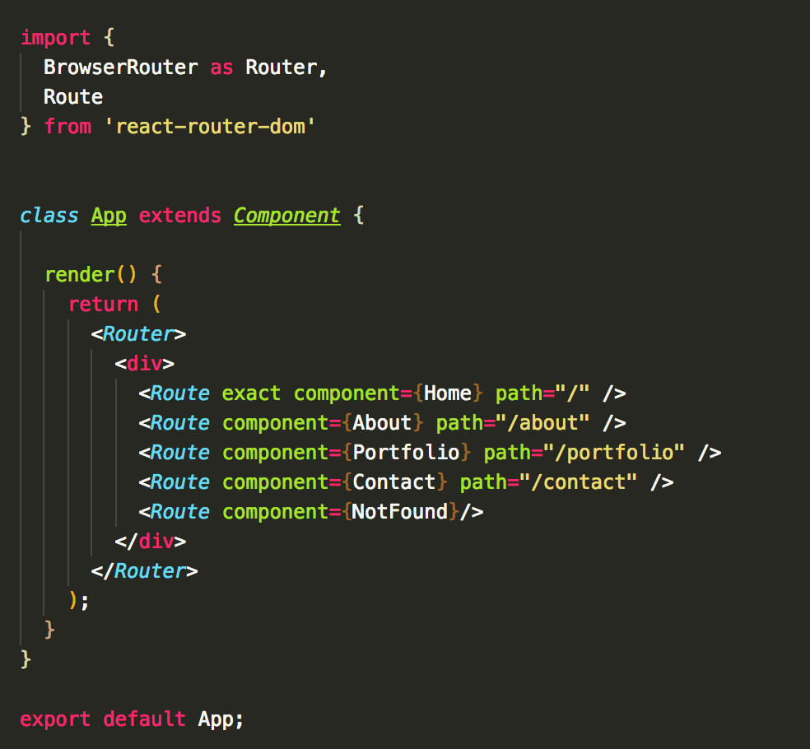
Basic Configuration
Notes:
There’s more to a React Component, but will get to that in a bit

Slide 14
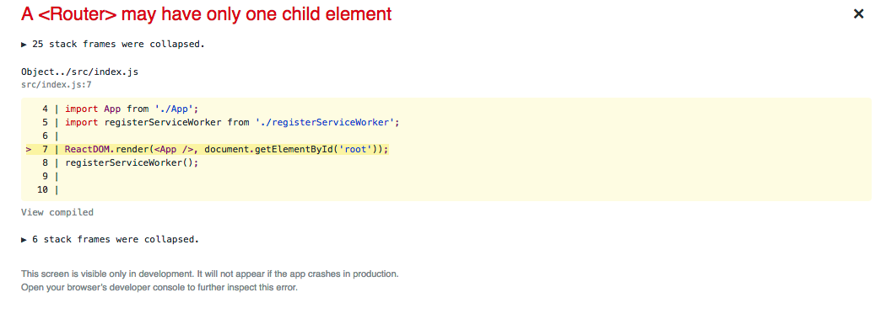
Basic configuration
Router must have one child element. If we remove wrapping div we will get the following error:
Notes:
There’s more to a React Component, but will get to that in a bit

Slide 15
Route
Used to define what component to render when path is matched.
Can be used anywhere, hence providing dynamic routing behavior
Route main props:
path – defines the matching path, supports regex
component – uses React.createElement under the hood to create new React element
render – used for inline rendering – a function is called whenever path matches
children – same as render, but is always rendered
Notes:
Children – a function, always rendered, can use to render something in respect to current match. (e.g. animation – fade-in/fade-out)

Slide 16
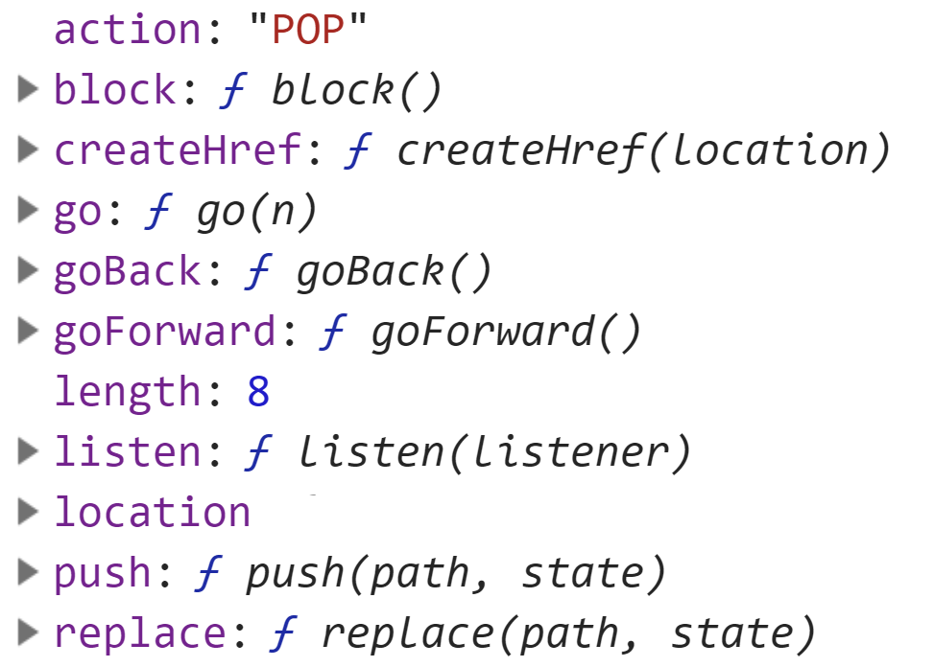
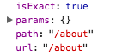
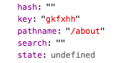
Routes Matching
Route passes match, location and history as props to rendered components
match - route configuration null if unmatched (using children)
location -
history -
Notes:
There’s more to a React Component, but will get to that in a bit

Slide 17
Routes Matching
There are several route qualifiers that help us with route matching
exact
path matches window.location.pathname exactly
strict
path with trailing slash will match only a path with a trailing slash
Notes:
There’s more to a React Component, but will get to that in a bit

Slide 18
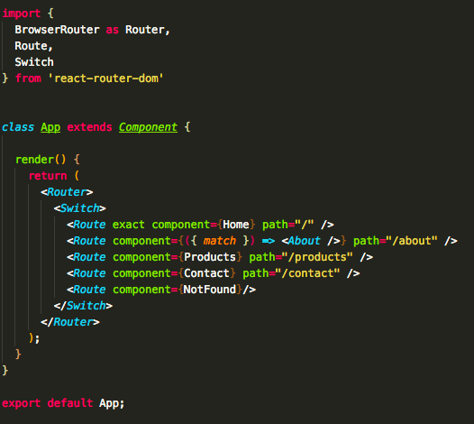
Switch Component
Renders only the first route that matches
Notes:
There’s more to a React Component, but will get to that in a bit

Slide 19
Notes:
Add

Slide 20
Passing URL Params
URL params can be passed by using :paramName syntax in Route path definition. For example:
Params can be specified as optional by using '?' sign after
URL params can be accessed from component from match object
<Route component={ProductPage} path="/products/:id" />
<Route component={ProductPage} path="/products/:id?" />
const ProductPage = ({ match }) => (<div>{ match.params.id }</div>)
Notes:
There’s more to a React Component, but will get to that in a bit

Slide 21
Parsing Query Strings
React Router provides a location prop with the following keys
pathname – current path
search – current query string
hash – current hash
To extract query string parameter you can use different packages or use URLSearchParams API
https://developer.mozilla.org/en-US/docs/Web/API/URLSearchParams
For example, to get referral from the following route: /products?referral=Amazon we will use the following:
new URLSearchParams(location.search).get('referral')
Notes:
There’s more to a React Component, but will get to that in a bit

Slide 22
Using Regex
You can use any regex when passing path prop to match route
Notes:
There’s more to a React Component, but will get to that in a bit

Slide 23
Notes:
Add

Slide 24
Rendering Multiple Components
Due to dynamic nature of React Router, Routes can be used anywhere
Centralized routes configuration can be created with multiple components rendered at various places on the page for each route
Alternatively, at any place that needs specific behavior added for specific Route, it can be added
Notes:
There’s more to a React Component, but will get to that in a bit

Slide 25
Notes:
Add

Slide 26
Links and History

Slide 27
Link Routes
Can use Link to navigate between pages
to –accepts object or string
string - navigates to specified route
object – navigates to route passed in pathname key. Query string can be in search key
replace
Normally, client side routing uses HTML5 history API
When clicking back, a route is popped from the history object
When using replace, current route is replaced with the new one
Eliminates current route from history (back navigates to previous page)
Notes:
There’s more to a React Component, but will get to that in a bit

Slide 28
Style active links with NavLink
NavLink component is used to style links, has following props
activeClassName: string
classname to add when route is active (default: 'active')
activeStyle: object
style to apply when route is active
exact: bool
same as for Route but applies style only when route matches exactly
isActive: func
Provide custom logic to determine if active or not
Receives match and location as arguments
to – same as for Link
location
Defaults to matching against browser URL, can set different location if needed
Notes:
There’s more to a React Component, but will get to that in a bit

Slide 29
History
React router uses the following history package to manage history:
https://github.com/ReactTraining/history
History has the following properties and methods:
length
action
location
pathname
search
state
push(path, [state])
replace(path, [state])
go()
goBack()
goForward()
block(prompt)
Notes:
There’s more to a React Component, but will get to that in a bit

Slide 30
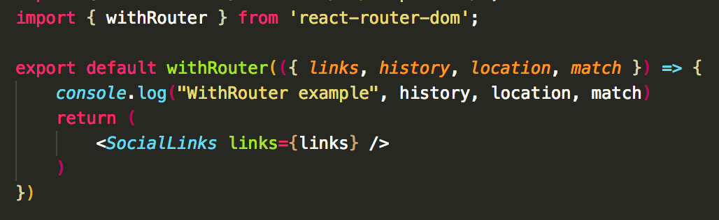
Access History
React Router gives withRouter HOC
Can access match, location or history from anywhere
Notes:
There’s more to a React Component, but will get to that in a bit

Slide 31
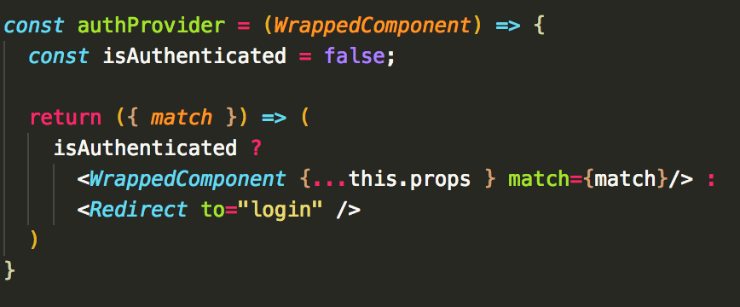
Redirect
Rendering Redirect component navigates to new location
For example let’s create authProvider HOC:
And usage:
to: string/object - location to redirect to.
push: bool - redirect will push new entry in history instead of replacing (default: false)
from: string – can be used only in a Switch component
Notes:
Redirect from – ability to pass parameters plus match it only when it comes from a specific route
<Switch>
<Redirect from='/old-path' to='/new-path'/>
<Route path='/new-path' component={Place}/>
</Switch>
// Redirect with matched parameters
<Switch>
<Redirect from='/users/:id' to='/users/profile/:id'/>
<Route path='/users/profile/:id' component={Profile}/>
</Switch>

Slide 32
Notes:
Add

Slide 33
Transitions

Slide 34
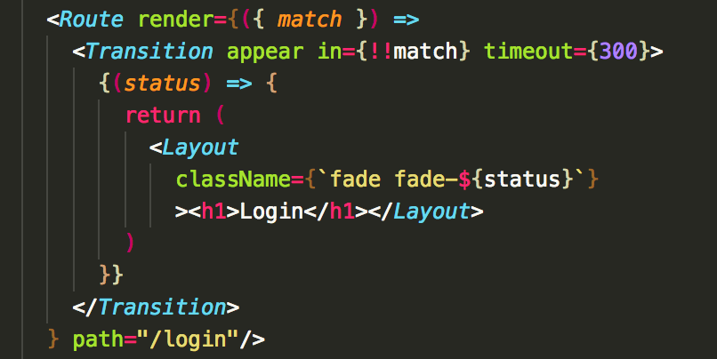
Animated transitions between pages
Many alternatives as any app, not necessarily React
A popular one is react-transition-group/Transition
Notes:
Appear - Normally a component is not transitioned if it is shown when the <Transition> component mounts. If you want to transition on the first mount set appear to true, and the component will transition in as soon as the <Transition> mounts.

Slide 35
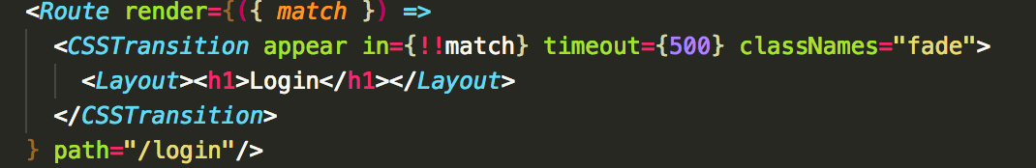
Animated transitions between pages
Another usage is react-transition-group/CSSTransition
Inspired by ng-animate library commonly used with Angular 1.x
Actually, there's already a library that binds the two together
https://github.com/maisano/react-router-transition
Notes:
There’s more to a React Component, but will get to that in a bit
Adds fade-appear as it mounts
Next tick - Adds fade-appear-active as it mounts
After timeout it removes both (done class names is added)

Slide 36
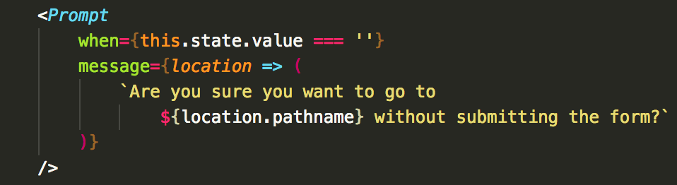
Intercept transitions with Prompt component
Prompt component is used to block transitions
Prompts the user for confirmation when “when” prop is true
Effect is customizable via 'getUserConfirmation' on BrowserRouter
Notes:
Customizable - https://gist.github.com/robertgonzales/e54699212da497740845712f3648d98c
<Router getUserConfirmation={getUserConfirmation}>
// default behavior uses window.confirmconst getUserConfirmation = (message, callback) => { const modal = document.createElement('div') document.body.appendChild(modal) const withCleanup = (answer) => { ReactDOM.unmountComponentAtNode(modal) document.body.removeChild(modal) callback(answer) } ReactDOM.render( <UserConfirmation message={message} onCancel={() => withCleanup(false)} onConfirm={() => withCleanup(true)} />, modal )}

Slide 37
Notes:
Add

Slide 38
React Router Docs overview
Now let’s overview React Router docs and how we can read guides properly
Notes:
There’s more to a React Component, but will get to that in a bit

Slide 40
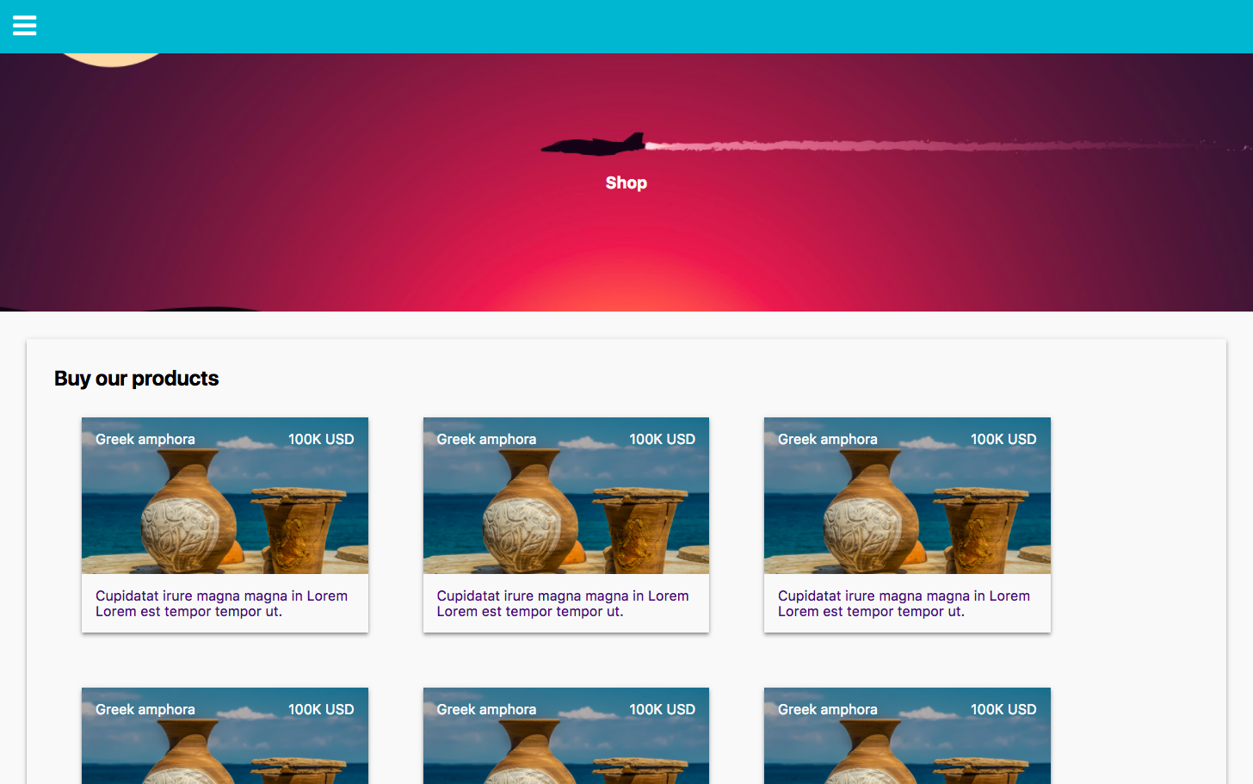
Exercise – React Shop navigation
Notes:
There’s more to a React Component, but will get to that in a bit

Slide 41
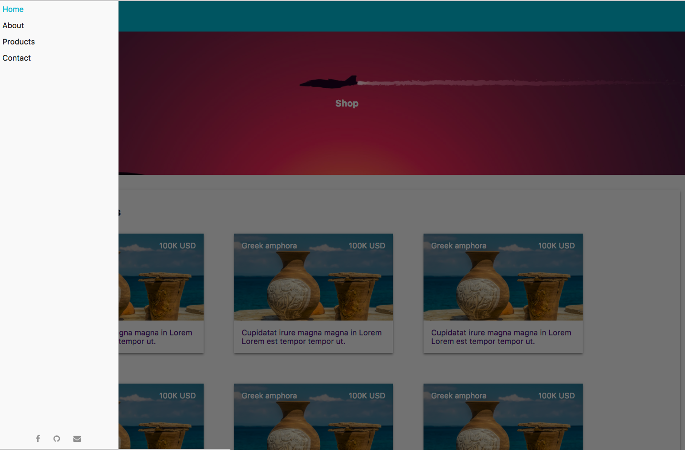
Exercise – React Shop navigation
Notes:
There’s more to a React Component, but will get to that in a bit

Slide 42
Exercise – React Shop Navigation
Using example provided during the lesson create simple shop application
The application has 6 views:
Home page view – A page containing featured sections with dummy text
About page – Contain dummy text or explanation about the actual shop
Products page – a grid of items with products. Refactor provided example to centralize products data. On Products page show the grid of product thumbnails, title, price and short description. Each product must be clickable and navigate to /products/productId path.
Notes:
There’s more to a React Component, but will get to that in a bit

Slide 43
Exercise – React Shop Navigation
Contact page – a page displaying the same form as on Home page as in example provided in the class. When form is filled (dirty) navigation to any other pages will trigger a Prompt: “Are you sure you want to navigate?”
Product page – a page displaying an actual product from Products list by id param passed in url. Url should be /products/id. On product page should be a big image of product, long description and price. There should be Buy button. When clicked, product should be added to cart. (Use meanwhile simple object passed down from App component) In later modules we will manage it properly
Notes:
There’s more to a React Component, but will get to that in a bit

Slide 44
Exercise – React Portfolio
Login page – on application navbar there should be a link to Login page or to Cart page. If user is logged in, Cart icon will be displayed. Clicking on it will lead to cart page. If user is not logged in, Sign in link will be displayed that will lead to Login page.
Cart page – should display a list of products that has been added to cart in the same way as on Product page. Will have Delete icon near each product. Clicking on it will delete the product
Notes:
There’s more to a React Component, but will get to that in a bit

